Slide 1
Unit – II WEB Scripting Languages

Slide 2
Outline
JavaScript: Overview of JavaScript, using JS in an HTML (Embedded, External), Data types, Control Structures, Arrays, Functions and Scopes, Objects in JS,
DOM: DOM levels, DOM Objects and their properties and methods, Manipulating DOM,
JQuery: Introduction to JQuery, Loading JQuery, Selecting elements, changing styles, creating elements, appending elements, removing elements, handling events.

Slide 3
Outline
JavaScript: Overview of JavaScript, using JS in an HTML (Embedded, External), Data types, Control Structures, Arrays, Functions and Scopes, Objects in JS,
DOM: DOM levels, DOM Objects and their properties and methods, Manipulating DOM,
JQuery: Introduction to JQuery, Loading JQuery, Selecting elements, changing styles, creating elements, appending elements, removing elements, handling events.

Slide 4
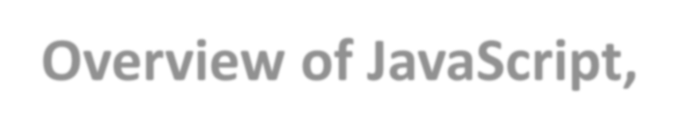

JavaScript- Outline
Overview of JavaScript,
using JS in an HTML (Embedded, External),
Data types,
Control Structures,
Arrays,
Functions
Objects
Scopes

Slide 5
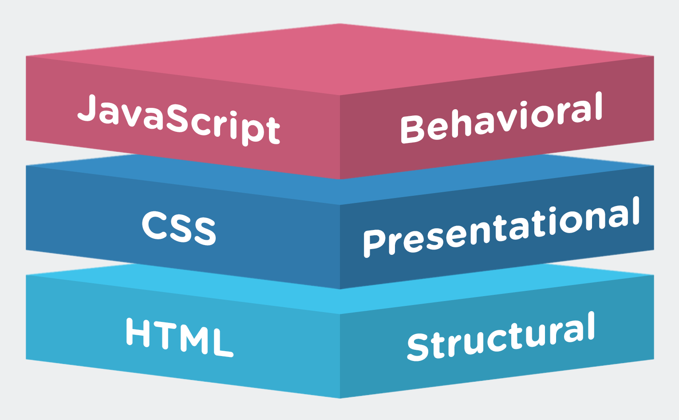
JavaScript – Introduction
A programming language designed for web pages
It is embedded directly into HTML Pages
An interpreted, client-side, event based language
It is dynamic, lightweight and case-sensitive

Slide 6
Overview of JavaScript,
JavaScript is one of the 3 languages all web developers must
learn:
1. HTML to define the content of web pages
2. CSS to specify the layout of web pages
3. JavaScript to program the behavior of web pages
JavaScript is a very powerful client-side scripting language.
client side scripting is a process in which scripts are executed by browsers without connecting the server.
Javascript is a dynamic computer programming language.
•

Slide 7
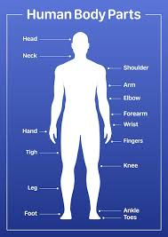

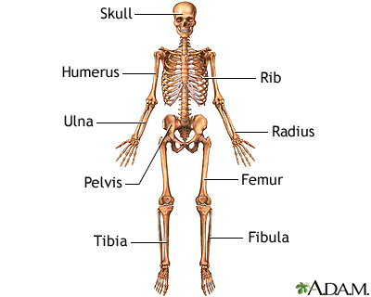
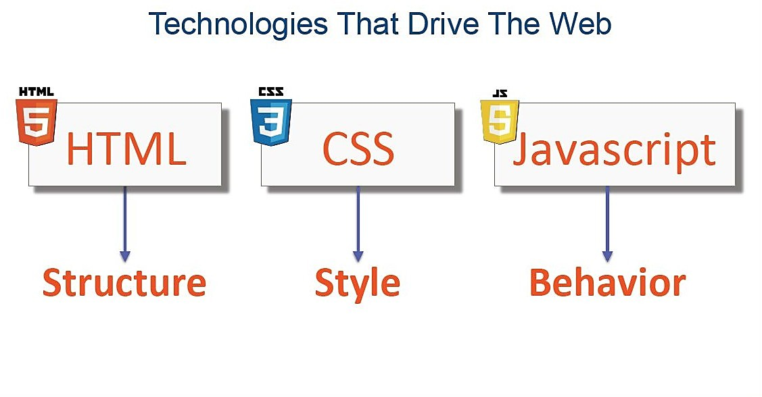
Example

Slide 8
Client-Side Script
When client makes the request, the HTML and all scripts will be downloaded into your browser and then the resultant HTML will be displayed in the browser is called client-side script.
λ
Example: JavaScript, VB-Script etc.

Slide 9
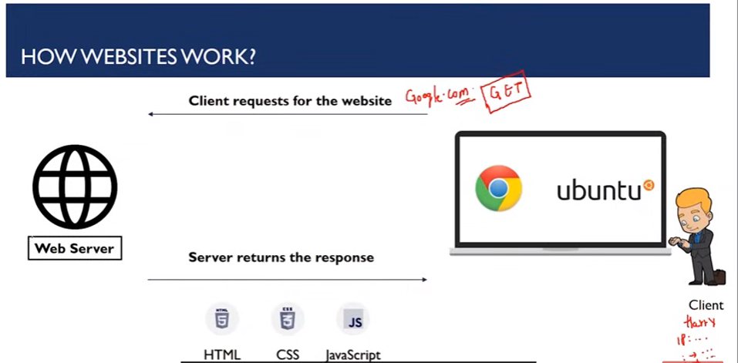
How Website Works

Slide 10
JavaScript
JavaScript is a front-end scripting language developed by Netscape for dynamic content
Lightweight, but with limited capabilities
Can be used as object-oriented language
Client-side technology
Embedded in your HTML page
Interpreted by the Web browser
Simple and flexible
Powerful to manipulate the DOM
6

Slide 11
JavaScript Advantages
JavaScript allows interactivity such as:
Implementing form validation
React to user actions, e.g. handle keys
Changing an image on moving mouse over it
Sections of a page appearing and disappearing
Content loading and changing dynamically
Performing complex calculations
Custom HTML controls, e.g. scrollable table
Implementing AJAX functionality
7

Slide 12
What Can JavaScript Do?
Can handle events
Can read and write HTML elements
Can validate form data
Can access / modify browser cookies
Can detect the user’s browser and OS
Can be used as object-oriented language
Can handle exceptions
Can perform asynchronous server calls (AJAX)
8

Slide 13
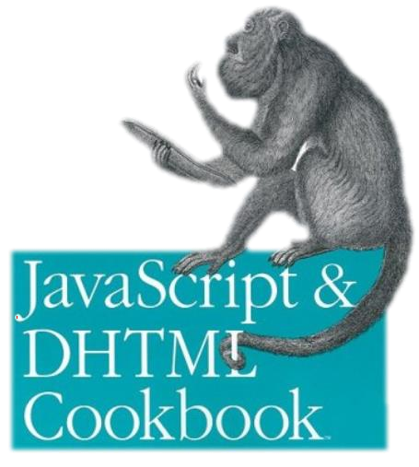

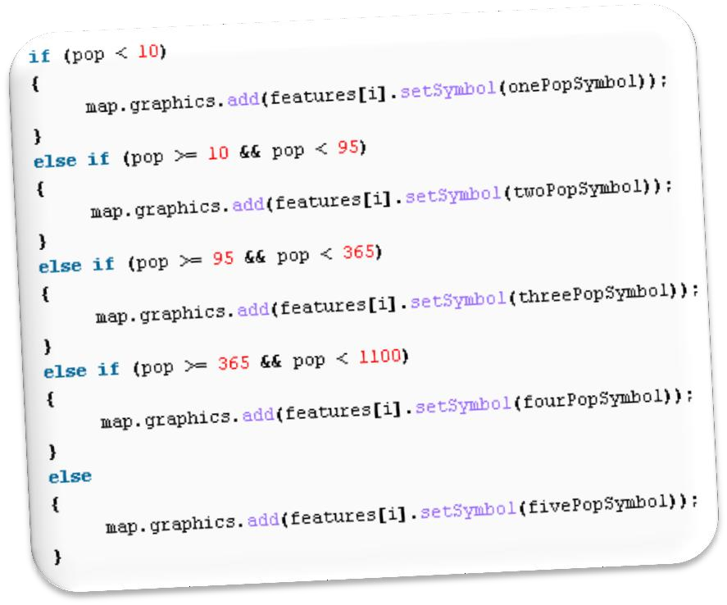



The JavaScript
Syntax

Slide 14
JavaScript Syntax
JavaScript can be implemented using <script>... </script> HTML tags in a web page.
Place the <script> tags, within the <head> tags.
Syntax:
<script language="javascript" type="text/javascript">
//JavaScript code
</script>

Slide 15
JavaScript Editor and Extension
Use Notepad to write the code
Save the document using .html (if embedded JavaScript)
Save document with .js (if external JavaScript)
Run the code in brower

Slide 16
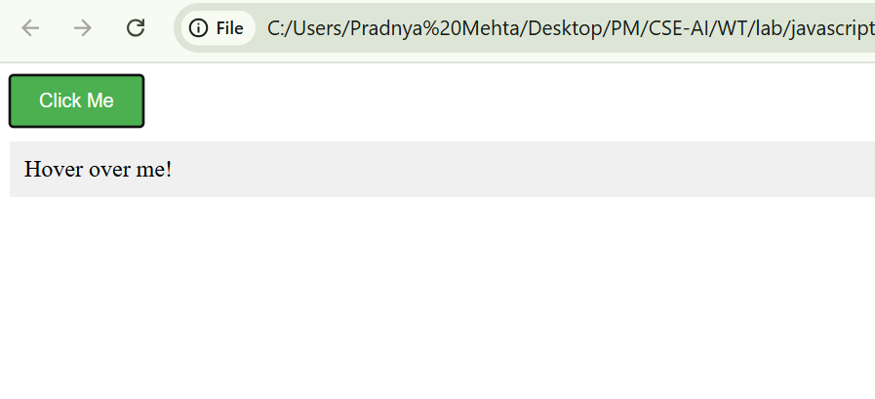
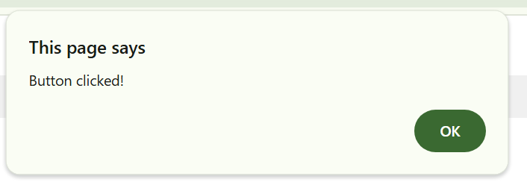
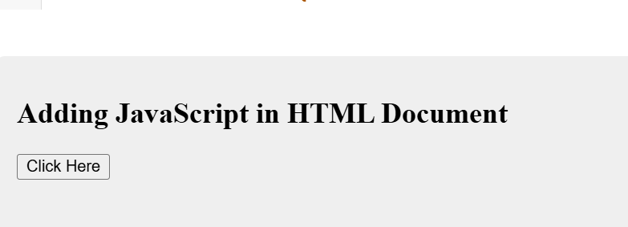
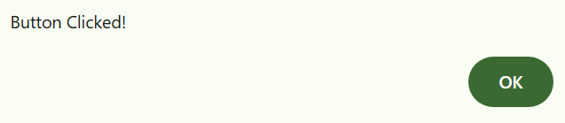
Inline JavaScript
You can write JavaScript code directly inside the HTML element using the onclick, onmouseover, or other event handler attributes.
<html>
<head></head>
<body>
<h2>
Adding JavaScript in HTML Document
</h2>
<button onclick="alert('Button Clicked!')">
Click Here
</button>
</html>
AI Generated code with ZZZ

Slide 17
JavaScript Syntax
Example:
<html>
<body>
<script language="javascript" type="text/javascript">
document.write("Hello World!")
</script>
</body>
</html>
JS Embedded in HTML Output
Hello World!
External JS

Slide 18
JavaScript Syntax
The JavaScript syntax is similar to C# and Java
Operators (+, *, =, !=, &&, ++, …)
Variables (typeless)
Conditional statements (if, else)
Loops (for, while)
Arrays (my_array[]) and associative arrays (my_array['abc'])
Functions (can return value)
Function variables (like the C# delegates)
12

Slide 19
Enabling JavaScript in Browsers
JavaScript in Firefox
Open a new tab → type about: config in the address bar.
Then you will find the warning dialog.
Select I’ll be careful, I promise!
Then you will find the list of configure options in the browser.
In the search bar, type javascript.enabled.
There you will find the option to enable or disable javascript by right-clicking on the value of that option → select toggle.

Slide 20
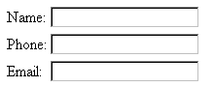
Naming Form Elements in HTML
<form name="addressform">
<label for="yourname"> Name:</label>
<input type="text" id="yourname" name="yourname"><br><br>
<label for="phone">Phone:</label>
<input type="tel" id="phone" name="phone"><br><br>
<label for="email">Email:</label>
<input type="email" id="email" name="email"><br><br> </form>
Click Here

Slide 21
JavaScript - Placement in HTML File
There is a flexibility given to include JavaScript code anywhere
in an HTML document.
However the most preferred ways to include JavaScript in an HTML file are as follows −
Script in <head>...</head> section.
Script in <body>...</body> section.
Script in <body>...</body> and <head>...</head> sections.
Script in an external file and then include in
<head>...</head> section.

Slide 22
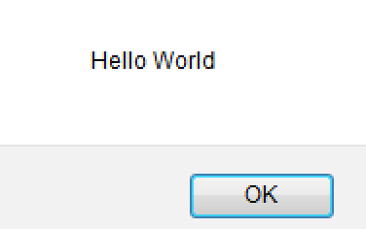
JavaScript in <head>...</head> section
<html>
<head>
<script type="text/javascript">
<!-- function sayHello()
{ alert("Hello World") }
//--> </script>
</head>
<body>
<input type="button" onclick="sayHello()" value="Say Hello" />
</body>
</html>
This code will produce the following results −

Slide 23
JavaScript in <body>...</body> section
<html>
<head> </head>
<body>
<script type="text/javascript">
<!--
document.write("Hello World")
//-->
</script>
<p>This is web page body </p>
</body>
</html>
This code will produce the following results −
Hello World
This is web page body
See Demo

Slide 24
JavaScript in <body> and <head>
<html>
<head>
<script type="text/javascript">
<!-- function sayHello()
{ alert("Hello World") } //-->
</script>
</head>
<body>
<script type="text/javascript">
<!-- document.write("Hello World") //-->
</script>
<input type="button" onclick="sayHello()" value="Say Hello" />
</body> </html>
This code will produce the following result −

Slide 25
JavaScript in External File
HTML File
<html>
<head>
<script type="text/javascript" src="filename.js" >
</script>
</head>
<body> ....... </body>
</html>
JavaScript File – filename.js
function sayHello()
{ alert("Hello World") }
Another Example- Feedback

Slide 26
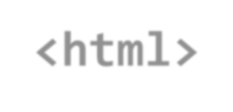


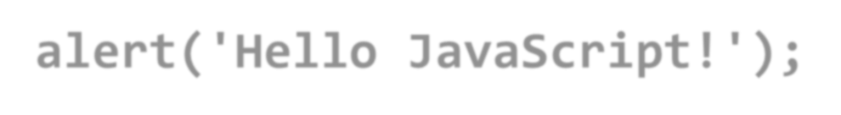
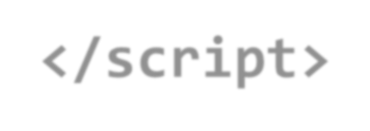
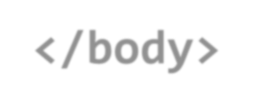
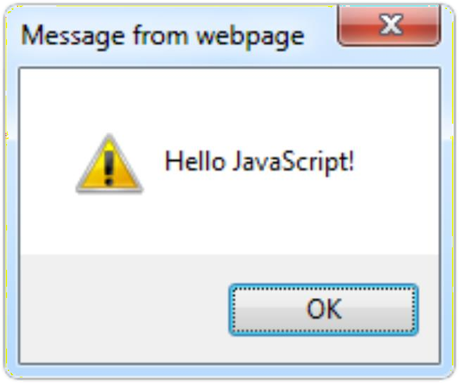

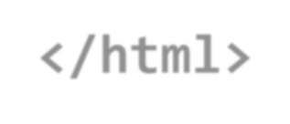
The First Script
first-script.html
<html>
<body>
<script type="text/javascript"> alert('Hello JavaScript!');
</script>
</body>
</html>
20

Slide 27
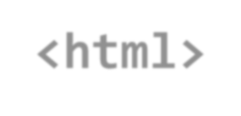



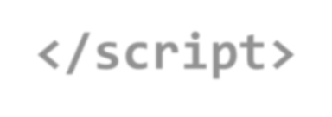
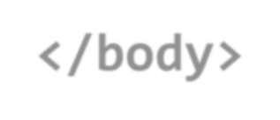
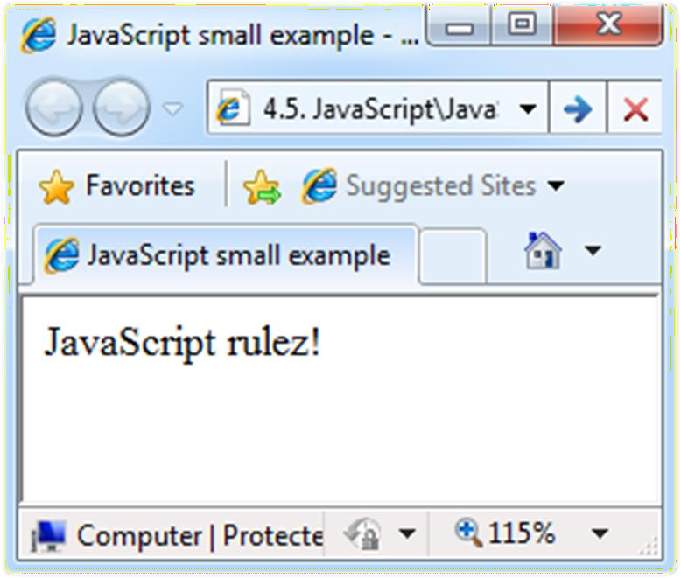

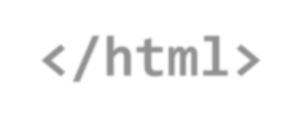
Another Small Example
small-example.html
<html>
<body>
<script type="text/javascript"> document.write('JavaScript rulez!');
</script>
</body>
</html>
21

Slide 28





Using JavaScript Code
The JavaScript code can be placed in:
<script> tag in the head
<script> tag in the body – not recommended
External files, linked via <script> tag the head
Files usually have .js extension
Highly recommended
The .js files get cached by the browser
<script src="scripts.js" type="text/javscript">
<!– code placed here will not be executed! -->
</script>
22

Slide 29
JavaScript – When is Executed?
JavaScript code is executed during the page loading or when the browser fires an event
All statements are executed at page loading
Some statements just define functions that can be called later
Function calls or code can be attached as "event handlers" via tag attributes
Executed when the event is fired by the browser
23
<img src="logo.gif" onclick="alert('clicked!')" />

Slide 30





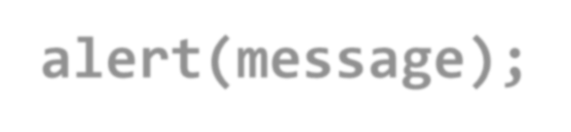
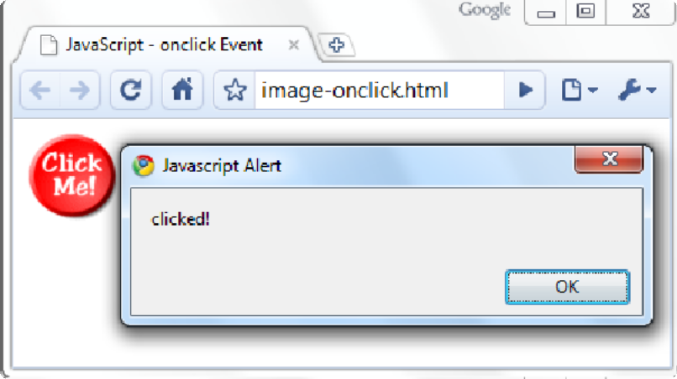
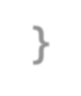

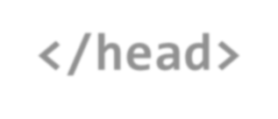

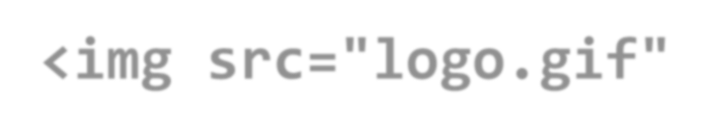



Calling a JavaScript Function from Event Handler – Example
<html>
<head>
<script type="text/javascript">
function test (message)
{
alert(message);
}
</script>
</head>
image-onclick.html
24
<body>
<img src="logo.gif" onclick="test('clicked!')" />
</body>
</html>

Slide 31





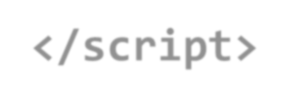


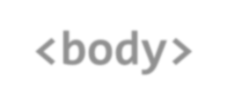

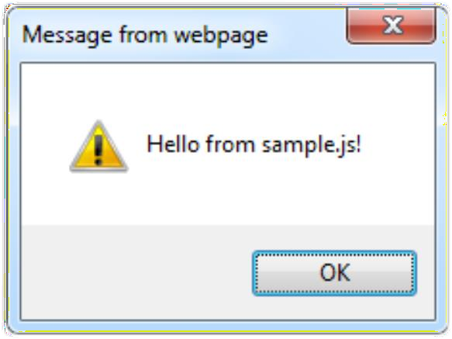
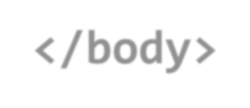

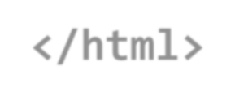
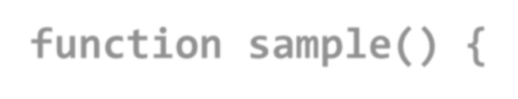

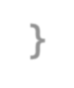

Using External Script Files
Using external script files:
<html>
<head>
external-JavaScript.html
<script src="sample.js" type="text/javascript">
</script>
</head>
<body>
The <script> tag is always empty.
25
<button onclick="sample()" value="Call JavaScript function from sample.js" />
</body>
</html>
External JavaScript file:
function sample() {
alert('Hello from sample.js!')
}
sample.js

Slide 32
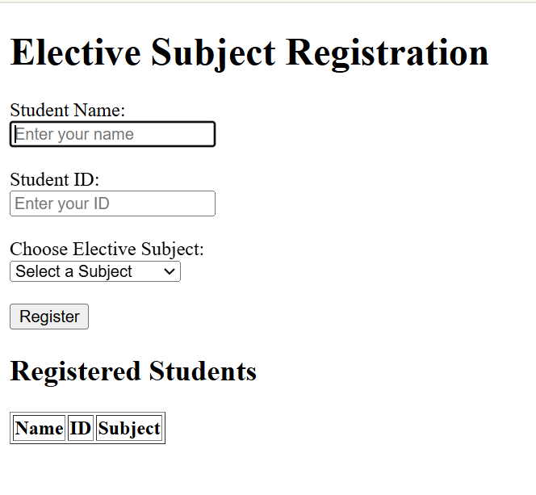
Assignment
Create a Registration form for Elective subjects
Output

Slide 33
Assignment
Write a JavaScript program that asks the user for their age and then prints out a message indicating whether they are eligible to vote or not
See the code

Slide 34
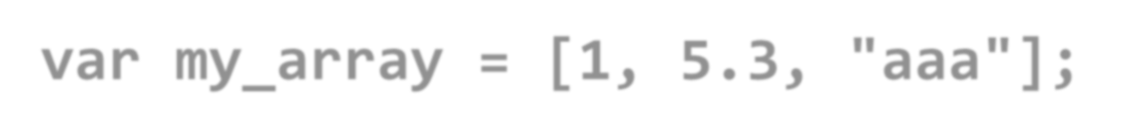
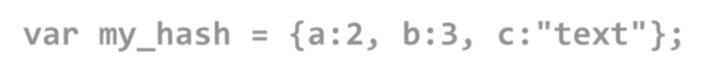
Data Types
JavaScript data types:
Numbers (integer, floating-point)
Boolean (true / false)
String type – string of characters
var myName = "Pradnya” console.log("Hello",myName)
26
Output: Hello Pradnya
var my_array = [1, 5.3, "aaa"];
Output: console.log(my_array);VM299:1 (3) [1, 5.3, 'aaa']
Associative arrays (hash tables)
var my_hash = {a:2, b:3, c:"text"};

Slide 35

Everything is Object
Every variable can be considered as object
For example strings and arrays have member functions:
objects.html
let test = "some string"; alert(test[7]); // shows letter 'r'
alert(test.charAt(5)); // shows letter 's' alert("test".charAt(2)); //shows letter 'e' alert("test".substring(1,3)); //shows 'es'
27
var arr = [1,3,4];
alert (arr.length); // shows 3 arr.push(7); // appends 7 to end of array alert (arr[1]); // shows 7

Slide 36
String Operations
The + operator joins strings
string1 = "fat ";
string2 = "cats";
alert(string1 + string2);
// fat cats
28
What is "9" + 9?
alert("9" + 9);
// 99
Converting string to number:
alert(parseInt("9") + 9);
// 18

Slide 37
Arrays Operations and Properties
Declaring new empty array:
var arr = new Array();
Declaring an array holding few elements:
var arr = [1, 2, 3, 4, 5];
29
Appending an element / getting the last element:
arr.push(3);
var element = arr.pop();
Reading the number of elements (array length):
arr.length;
Finding element's index in the array:
arr.indexOf(1);

Slide 38
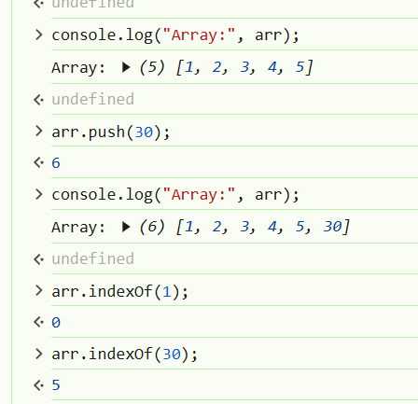
var arr = [1, 2, 3, 4, 5];
arr.push(3); // Add 3 to the end of the array
var element = arr.pop(); // Remove the last element and store it in 'element'
// Display the array and the value of 'element' in the console
console.log("Array:", arr); // Display the updated array
console.log("Popped Element:", element); // Display the removed element
Output:
Array: [1, 2, 3, 4, 5]
Popped Element: 3

Slide 39
Standard Popup Boxes
Alert box with text and [OK] button
Just a message shown in a dialog box:
alert("Some text here");
30
Confirmation box
Contains text, [OK] button and [Cancel] button:
confirm("Are you sure?");
Prompt box
Contains text, input field with default value:
prompt ("enter amount", 10);

Slide 40
JavaScript Variables
<script type="text/javascript">
var name = "Ali"; var money; money = 2000.50;
</script>

Slide 41
Sum of Numbers – Example
sum-of-numbers.html
<html>
<head>
<title>JavaScript Demo</title>
<script type="text/javascript">
function calcSum() { value1 =
parseInt(document.mainForm.textBox1.value); value2 =
parseInt(document.mainForm.textBox2.value); sum = value1 + value2; document.mainForm.textBoxSum.value = sum;
}
</script>
</head>
32

Slide 42
Sum of Numbers – Example (2)
sum-of-numbers.html (cont.)
<body>
<form name="mainForm">
<input type="text" name="textBox1" /> <br/>
<input type="text" name="textBox2" /> <br/>
<input type="button" value="Process"
onclick="javascript: calcSum()" />
<input type="text" name="textBoxSum" readonly="readonly"/>
</form>
</body>
</html>
Output:
33

Slide 43
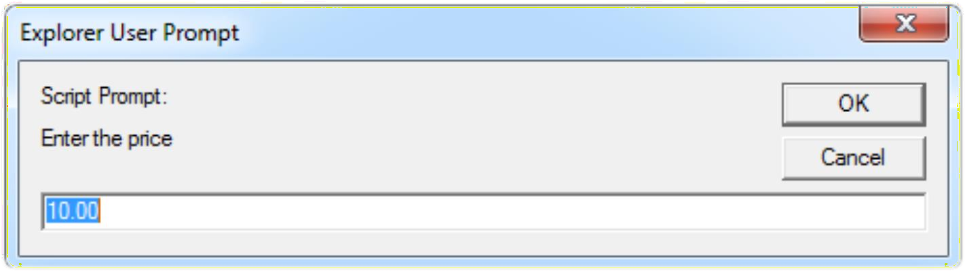

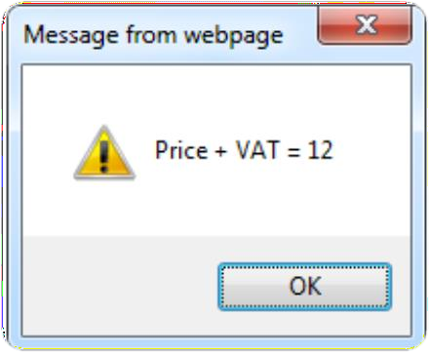

JavaScript Prompt – Example
prompt.html
price = prompt("Enter the price", "10.00"); alert('Price + VAT = ' + price * 1.2);
34

Slide 44
JavaScript - Operators
Arithmetic Operators
Comparison Operators
Logical (or Relational) Operators
Assignment Operators
Conditional (or ternary) Operators

Slide 45
Questions to solve
Create a JavaScript object that represents a person with properties name, age, and city. Then, print out the values of these properties to the console
Create a JavaScript array that contains a mix of data types (e.g. numbers, strings, booleans). Then, print out the values of the array to the console.
Write a JavaScript program that uses the prompt() function to ask the user for their name and then prints out a greeting message with the user's name.

Slide 46
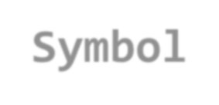

















Conditional Statement (if)
unitPrice = 1.30;
if (quantity > 100) {
unitPrice = 1.20;
}
36
Symbol
Meaning
>
Greater than
<
Less than
>=
Greater than or equal to
<=
Less than or equal to
==
Equal
!=
Not equal

Slide 47
Solve
Create a JavaScript function that takes a grade as an input and prints out a message indicating whether the grade is passing or failing.
function checkGrade(grade) {
if (grade >= 50) {
console.log("Passing grade!");
} else {
console.log("Failing grade.");
}
}
// Example usage:
checkGrade(75); // Output: Passing grade!
checkGrade(45); // Output: Failing grade.

Slide 48


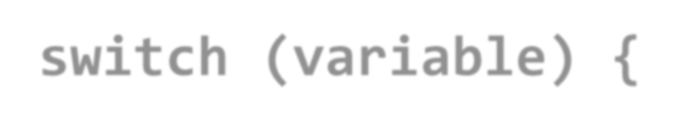








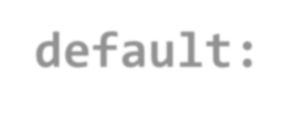

Switch Statement
The switch statement works like in C#:
switch (variable) { case 1:
// do something break;
case 'a':
// do something else
break; case 3.14:
// another code break;
default:
switch-statements.html
37
// something completely different
}

Slide 49
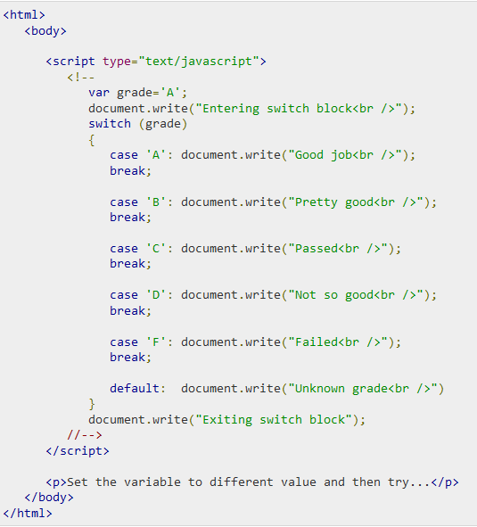
Switch case Example

Slide 50
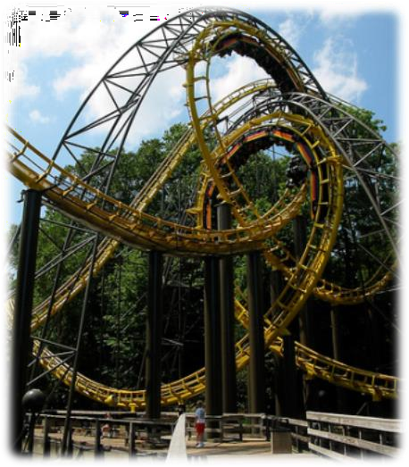













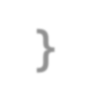
Loops
Like in C#
for loop
while loop
do … while loop
39
var counter;
for (counter=0; counter<4; counter++)
{
alert(counter);
}
while (counter < 5)
{
alert(++counter);
}
loops.html

Slide 51
While-loop Example
<!DOCTYPE html>
<html>
<head>
<title>While Loop Example</title>
</head>
<body> <script type="text/javascript">
var count = 0;
document.write("Starting Loop<br />");
while (count < 10)
{ document.write("Current Count : " + count + "<br />");
count++; }
document.write("Loop stopped!");
</script>
</body>
</html>

Slide 52
Assignment
Write a JavaScript program that uses a switch statement to print out a message based on the day of the week.
Create a JavaScript loop that prints out the numbers from 1 to 10 using a while loop.
Write a JavaScript program that uses a for-in loop to iterate over the properties of an object and print out their values.

Slide 53



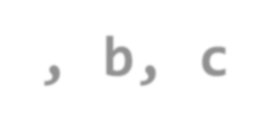















Functions
Code structure – splitting code into parts
Data comes in, processed, result returned
Parameters come in here.
41
Declaring variables is optional. Type is never declared.
Value returned
here.

Slide 54










Function Arguments & Return Value
Functions are not required to return a value
When calling function it is not obligatory to specify all of its arguments
The function has access to all the arguments passed via arguments array
42

Slide 55
JavaScript Function Syntax
function name(parameter1, parameter2, parameter3) {
code to be executed
}
var x = myFunction(4, 3); // Function is called, return value will end up in x
function myFunction(a, b) {
return a * b; and b
}
// Function returns the product of a

Slide 56
????
Write a JavaScript program that uses a function to calculate the area of a rectangle.
Create a JavaScript function that takes a string as input and returns the string with all vowels removed.
Write a JavaScript program that uses a function to determine whether a number is prime or not.
Create a JavaScript function that takes an array as input and returns the array with all duplicates removed.

Slide 57
Introduction to ES6
https://www.geeksforgeeks.org/introduction-to-es6/
Arrow Functions
// Regular function function add(a, b)
{ return a + b;}// Arrow function with a different name
const addArrow = (a, b) => a + b;
console.log(add(5, 3)); // Output: 8
console.log(addArrow(10, 20)); // Output: 30
Note: In JavaScript, you cannot declare the same variable name more than
once using let or const in the same scope.

Slide 58
Outline
JavaScript: Overview of JavaScript, using JS in an HTML (Embedded, External), Data types, Control Structures, Arrays, Functions and Scopes, Objects in JS,
DOM: DOM levels, DOM Objects and their properties and methods, Manipulating DOM,
JQuery: Introduction to JQuery, Loading JQuery, Selecting elements, changing styles, creating elements, appending elements, removing elements, handling events.

Slide 59
HTML CSS JAVASCRIPT
Adds structure to our web pages
Tags used for e.g. <p>, <div>, <section>
Adds styles to website
e.g. color, border, margin, image, position, etc
Can use ids, classes or direct tags to refer HTML tags
It adds programming to our web pages
Adds Functionality
e.g. client side validation, effects and events

Slide 60
What is the DOM?
The DOM is a W3C (World Wide Web Consortium) standard.
The DOM defines a standard for accessing documents:
The W3C DOM standard is separated into 3 different parts:
Core DOM - standard model for all document types
XML DOM - standard model for XML documents
HTML DOM - standard model for HTML documents

Slide 61
Document Object Model
DOM (Document Object Model) is a programming interface for web documents
It represents the structure of an HTML or XML document as a tree of objects.
allowing programs to interact with, modify, and update the content, structure, and style dynamically.

Slide 62

DOM- Document Object Mode
When a web page is loaded, the browser creates a Document Object Model of the page.
The HTML DOM model is constructed as a tree of Objects:

Slide 63


HTML and DOM

Slide 64
Benefits of DOM to JavaScript
With the object model, JavaScript gets all the power it needs to create dynamic HTML:
JavaScript can change all the HTML elements in the page
JavaScript can change all the HTML attributes in the page
JavaScript can change all the CSS styles in the page
JavaScript can remove existing HTML elements and attributes
JavaScript can add new HTML elements and attributes
JavaScript can react to all existing HTML events in the page
JavaScript can create new HTML events in the page

Slide 65
DOM Levels
DOM Level 1
DOM Level 2
DOM Level 3

Slide 66
DOM Level 0 (Legacy DOM)
used in Netscape Navigator 2 and Internet Explorer 3.
a collection of predefined objects (like document, window, forms, images) that allowed limited interaction with elements
It did not provide full access to the document structure.

Slide 67

Example DOM Level 0
<!DOCTYPE html>
<html>
<head>
<title>DOM Level 0 Example</title>
</head>
<body>
<button onclick="alert('Hello!')">Click Me</button>
</body>
</html>

Slide 68
DOM Level 1
better document structure and scripting capabilities.
Levels
Core
HTML
access and manipulate XML and HTML documents.
methods and properties specifically for handling HTML documents.

Slide 69
Core DOM way for programming languages like JavaScript to interact with, modify, and manipulate documents dynamically.
Each HTML or XML element is a node.
Attributes and text inside elements are child nodes.
The entire document is represented as the root node.
Example:
<!DOCTYPE html>
<html>
<head>
<title>Core DOM Example</title>
</head>
<body>
<h1>Hello, World!</h1>
</body>
</html>
Tree structure
Document
├── <html>
│ ├── <head>
│ │ ├── <title> → "Core DOM Example"
│ ├── <body>
│ │ ├── <h1> → "Hello, World!"

Slide 70
Types of Nodes in Core DOM
1. Document Node
entire document.
root node of the DOM tree.
Example: document
2. Element Node
Represents HTML or XML elements.
Example: <h1>, <p>, <div>, <body>
3. Attribute Node
Represents attributes of an element.
Example: id="heading", class="text“
4. Text Node
Represents the text inside an element.
Example: The text "Hello, World!" inside <h1>Hello, World!</h1>

Slide 71
Core DOM Methods
1. Accessing Elements
getElementById(id) → Selects an element by its ID.
getElementsByTagName(tag) → Selects all elements with a given tag name.
getElementsByClassName(class) → Selects elements by their class name.
querySelector(selector) → Selects the first element matching a CSS selector.
querySelectorAll(selector) → Selects all elements matching a CSS selector.

Slide 72

Example
<!DOCTYPE html>
<html>
<body>
<h1 id="heading">Hello, World!</h1>
<script>
var element = document.getElementById("heading");
console.log(element.innerHTML); // Output: Hello, World!
</script>
</body>
</html>

Slide 73



2. Modifying Elements
innerHTML → Changes the HTML inside an element.
setAttribute(name, value) → Modifies
an attribute of an element.
createElement(tag) → Creates a new element.
appendChild(node) → Adds a new child to an element.

Slide 74

3. Creating and Adding Elements
<!DOCTYPE html>
<html>
<body>
<div id="container"></div>
<script>
var newElement = document.createElement("p"); // Create <p> element
newElement.innerHTML = "This is a new paragraph!"; // Add text
document.getElementById("container").
appendChild(newElement); // Add it to the div
</script>
</body>
</html>

Slide 75
Structure of HTML DOM Level 1
Each element is a node.
Text inside elements is a child node.
Attributes are associated with elements but not part of the child nodes.
Tree
Document
├── <html>
│ ├── <head>
│ │ ├── <title> → "DOM Level 1 Example"
│ ├── <body>
│ │ ├── <h1 id="heading"> → "Hello, World!"
<!DOCTYPE html>
<html>
<head>
<title>DOM Level 1 Example</title>
</head>
<body>
<h1 id="heading">Hello, World!</h1>
</body>
</html>

Slide 76
1. Accessing Elements
Method | Description
document.getElementById("id") | Selects an element by its id.
document.getElementsByTagName("tag") | Selects elements by their tag name.
document.getElementsByClassName("class") | Selects elements by their class name.

Slide 77
Example
<!DOCTYPE html>
<html>
<body>
<h1 id="title">Hello, DOM Level 1!</h1>
<script>
var element = document.getElementById("title");
console.log(element.innerHTML); // Output: Hello, DOM Level 1!
</script>
</body>
</html>
Output:
Hello, DOM Level 1!

Slide 78
2. Modifying Elements
Method | Description
innerHTML | Modifies the content inside an element..
setAttribute(name, value) | Modifies an attribute of an element.
Refer slide no 73 Eg.

Slide 79

3. Handling Events
onclick= function()- Runs a function when the element is clicked."

Slide 80
DOM Level 1
The DOM Level 1 specification is separated into two parts:
Core and
HTML.
Core Level 1 provides a low-level set of fundamental interfaces that can represent any structured document, as well as defining extended interfaces for representing an XML document.
HTML Level 1 provides additional, higher-level interfaces that are used with the fundamental interfaces defined in Core Level 1 to provide a more convenient view of an HTML document. Interfaces introduced in DOM1 include, among others, the Document, Node, Attr, Element, and Text interfaces.

Slide 81
DOM Level 2 (Enhanced Features)
Introduced in 2000, DOM Level 2 added support for:
Events (addEventListener, removeEventListener)
Style manipulation (getComputedStyle)
Namespace support for XML documents.
It allowed more dynamic interaction with HTML and XML documents.

Slide 82

Example

Slide 83
DOM Level 2
The DOM Level 2 specification contains six different specifications:
The DOM2 Core,
Views,
Events,
Style,
Traversal and Range, and
the DOM2 HTML. Most of the DOM Level 2 is supported in Mozilla.

Slide 84
DOM Level 2
Specification | Description
DOM Level 2 Core | helps the programs and scripts to access and update the content and structure of document dynamically
DOM Level 2 Views | allows programs and scripts to dynamically access and update the content of an HTML or XML document
DOM Level 2 Events | provides a generic event system to programs and scripts
DOM Level 2 Style | allows programs and scripts to dynamically access and update the content of style sheets
DOM Level 2 Traversal and Range | allows programs and scripts to dynamically traverse and identify a range of content in a document
DOM Level 2 HTML | allows programs and scripts to dynamically access and update the content and structure of HTML 4.01 and XHTML 1.0 documents

Slide 85
DOM Level 3
The DOM Level 3 specification contains five different specifications:
The DOM3 Core,
Load and Save,
Validation,
Events, and
XPath.

Slide 86
DOM Level 3 (Advanced Capabilities)
Introduced in 2004, DOM Level 3 added:
Better XML handling (DOM Load and Save)
Support for XPath and validation of documents.
Enhanced event handling.

Slide 87

Example

Slide 88
DOM Level 3
Specification | Description
DOM Level 3 Core | allows programs and scripts to dynamically access and update the content, structure, and document style
DOM Level 3 Load and Save | allows programs and scripts to dynamically load the content of an XML document into a DOM document
DOM Level 3 Validation | allows programs and scripts to dynamically update the content and structure of documents and ensures that the document remains valid

Slide 89
DOM Objects and their properties and methods
In the DOM, all HTML elements are defined as objects.
The programming interface is the properties and methods of each object.
HTML DOM properties are values (of HTML Elements) that
you can set or change.
HTML DOM methods are actions you can perform (on HTML Elements). A method is an action you can do (like add or deleting an HTML element).

Slide 90


DOM Example 1
The following example changes the content (the innerHTML) of the <p> element with id="demo":
Example
<html>
<body>
<p id="demo"></p>
<script>
Output
document.getElementById("demo").innerHTML = "Hello World!";
</script>
</body>
</html>
In the example above, getElementById is a method, while innerHTML is a property.

Slide 91
getElementById & innerHTML
The getElementById Method
The most common way to access an HTML element is to use the id of the element.
In the example above the getElementById method used id="demo" to find the element.
The innerHTML Property
The easiest way to get the content of an element is by using the innerHTML property.
The innerHTML property is useful for getting or replacing the
content of HTML elements.
The innerHTML property can be used to get or change any HTML element, including <html> and <body>.

Slide 92
Finding HTML Elements
Method | Description
document.getElementById(id) | Find an element by element id
document.getElementsByTagName(name) | Find elements by tag name
document.getElementsByClassName(name) | Find elements by class name

Slide 93
Changing HTML Elements
Method | Description
element.innerHTML = new html content | Change the inner HTML of an element
element.attribute = new value | Change the attribute value of an HTML element
element.setAttribute(attribute, value) | Change the attribute value of an HTML element
element.style.property = new style | Change the style of an HTML element

Slide 94
Adding and Deleting Elements
Method | Description
document.createElement(element) | Create an HTML element
document.removeChild(element) | Remove an HTML element
document.appendChild(element) | Add an HTML element
document.replaceChild(element) | Replace an HTML element
document.write(text) | Write into the HTML output stream

Slide 95
Adding Events Handlers
Method | Description
document.getElementById(id).onclick = function(){code} | Adding event handler code to an onclick event

Slide 96
Finding HTML Objects
Property | Description | DOM
document.baseURI | Returns the absolute base URI of the document | 3
document.body | Returns the <body> element | 1
document.cookie | Returns the document's cookie | 1
document.doctype | Returns the document's doctype | 3
document.forms | Returns all <form> elements | 1
document.head | Returns the <head> element | 3
document.images | Returns all <img> elements | 1

Slide 97
Changing HTML Content
Example
<html> <body>
<h2>JavaScript can Change HTML</h2>
<p id="p1">Hello World!</p>
<script>
document.getElementById("p1").innerHTML = "New text!";
</script>
<p>The paragraph above was changed by a script.</p>
</body> </html>
Output
JavaScript can Change HTML
New text!
The paragraph above was changed by a script.

Slide 98

Changing the Value of an Attribute
Example
<html><body>
<img id="image" src="smiley.gif" width="160" height="120">
<script>
document.getElementById("image").src = "landscape.jpg";
</script>
<p>The original image was smiley.gif, but the script changed it to
landscape.jpg</p>
</body></html>
Output

Slide 99
Outline
JavaScript: Overview of JavaScript, using JS in an HTML (Embedded, External), Data types, Control Structures, Arrays, Functions and Scopes, Objects in JS,
DOM: DOM levels, DOM Objects and their properties and methods, Manipulating DOM,
JQuery: Introduction to JQuery, Loading JQuery, Selecting elements, changing styles, creating elements, appending elements, removing elements, handling events.

Slide 100
jQuery - Introduction
jQuery is a JavaScript Library.
jQuery greatly simplifies JavaScript programming.
jQuery is a lightweight
jQuery also simplifies a lot of the complicated things from JavaScript, like AJAX calls and DOM manipulation.
The jQuery library contains the following features:
HTML/DOM manipulation
CSS manipulation
HTML event methods
Effects and animations
AJAX
Utilities

Slide 101
Adding jQuery to Your Web Pages
There are several ways to start using jQuery on your web
site. You can:
Download the jQuery library from jQuery.com
Include jQuery from a CDN, like Google

Slide 102
Downloading jQuery
There are two versions of jQuery available for downloading:
Production version - this is for your live website because it has been minified and compressed
Development version - this is for testing and development
Both versions can be downloaded from jQuery.com.
The jQuery library is a single JavaScript file, and you reference it with the HTML <script> tag (notice that the <script> tag should be inside the <head> section):
<head>
<script src="jquery-3.2.1.min.js"></script>
</head>
Tip: Place the downloaded file in the same directory as the pages where you wish to use it.

Slide 103
jQuery CDN
If you don't want to download and host jQuery yourself, you can include it from a CDN (Content Delivery Network).
Both Google and Microsoft host jQuery.
To use jQuery from Google or Microsoft, use one of the following:
Google CDN:
<head>
<script src="https://ajax.googleapis.com/ajax/libs/jquery/3.2.1/jquery.min.js">
</script>
</head>

Slide 104
jQuery Syntax
With jQuery you select (query) HTML elements and perform "actions" on them.
syntax :
$(selector).action()
A $ sign to define/access jQuery
A (selector) to "query (or find)" HTML elements
A jQuery action() to be performed on the element(s)
Examples:
$(this).hide() - hides the current element.
$("p").hide() - hides all <p> elements.
$(".test").hide() - hides all elements with class="test".
$("#test").hide() - hides the element with id="test".

Slide 105
jQuery Selectors-Selecting elements
jQuery selectors allow you to select and manipulate HTML element(s).
jQuery selectors are used to "find" (or select) HTML elements based on their name, id, classes, types, attributes, values of attributes and much more. It's based on the existing CSS Selectors, and in addition, it has some own custom selectors.
All selectors in jQuery start with the dollar sign and parentheses: $().

Slide 106
The element Selector
The jQuery element selector selects elements based on the element name.
You can select all <p> elements on a page like this:
$("p")
Example
When a user clicks on a button, all <p> elements will be
hidden:
$(document).ready(function(){
$("button").click(function(){
$("p").hide();
});
}); Run : jquery11.html

Slide 107
The #id Selector
The jQuery #id selector uses the id attribute of an HTML tag to find the specific element.
An id should be unique within a page, so you should use the #id selector when you want to find a single, unique element.
To find an element with a specific id, write a hash character, followed by the id of the HTML element:
$("#test")
Example
When a user clicks on a button, the element with id="test" will be hidden:
$(document).ready(function(){
$("button").click(function(){
$("#test").hide();
});
}); Execute jquery13.html

Slide 108

jQuery css() Method- Changing Style
jQuery css() Method
The css() method sets or returns one or more style
properties for the selected elements.
Return a CSS Property
To return the value of a specified CSS property, use the following syntax:
css("propertyname");
Set a CSS Property
To set a specified CSS property, use the following syntax:
css("propertyname","value");

Slide 109






Changing Style-
Return a CSS Property Example
<html><head>
<script src="https://ajax.googleapis.com/ajax/libs/jquery/3.2.1/jquery.min.js"></sc ript>
<script>
$(document).ready(function(){
$("button").click(function(){
alert("Background color = " + $("p").css("background-color"));
});
});
</script>
</head><body>
<p style="background-color:#ff0000">This is a paragraph.</p>
<button>Return background-color of p</button>
</body></html> click:

Slide 110



Changing Style-
Return a CSS Property Example o/p
Output of Previous Code

Slide 111





Changing Style-
Set a CSS Property Example
<html><head> jquery19.html
<script src="https://ajax.googleapis.com/ajax/libs/jquery/3.2.1/jquery.min.js"></script>
<script>
$(document).ready(function(){
$("button").click(function(){
$("p").css("background-color", "yellow");
});
});
</script>
</head>
<body>
<p style="background-color:#ff0000">This is a paragraph.</p>
<button>Set background-color of p</button>
</body></html>

Slide 112









Changing Style-
Set a CSS Property Example o/p
Output of Previous Code
After clicking on button

Slide 113
jQuery - Add Elements
We will look at four jQuery methods that are used to add new content:
append() - Inserts content at the end of the selected elements
prepend() - Inserts content at the beginning of the selected elements
after() - Inserts content after the selected elements
before() - Inserts content before the selected elements

Slide 114





jQuery append() Method- Example
<html><head>
<script src="https://ajax.googleapis.com/ajax/libs/jquery/3.2.1/jquery.min.js"></scrip t>
<script>
$(document).ready(function(){
$("#btn1").click(function(){
$("ol").append("<li> List item 3 </li>");
}); }); </script>
</head>
<body>
<ol>
<li>List item 1</li>
<li>List item 2</li>
</ol>
After Clicking on button
<button id="btn1"> Append list items </button>
</body></html>

Slide 115
jQuery - Remove Elements
Remove Elements/Content
To remove elements and content, there are mainly two jQuery methods:
remove() - Removes the selected element (and its child elements)
empty() - Removes the child elements from the
selected element

Slide 116




jQuery remove() Method- Example
<html > <head>
<script src="https://code.jquery.com/jquery-1.10.2.js">
</script>
</head>
<body>
<p>Hello</p>
how are you?
<button>Remove </button>
<script>
$( "button" ).click(function() {
$( "p" ).remove();
});
</script>
</body></html>
After Clicking on button

Slide 117
References
https://www.tutorialspoint.com/javascript/javascript_quic
k_guide.htm
https://www.w3schools.com/js
https://www.w3schools.com/js/js_htmldom.asp
https://developer.mozilla.org/fr/docs/DOM_Levels
https://codescracker.com/js/js-dom-levels.htm
https://www.w3schools.com/jquery/jquery_get_started.a sp
https://www.w3schools.com/jquery/jquery_css.asp
https://www.w3schools.com/jquery/jquery_dom_add.asp

